Slide 1
EMPLOYEE DATA ANALYSIS USING
NAME :R.MANOJ
NM ID: F28BF9132B32BAFA7D6466549800B845
REGISTER NO : autunm110312201252
COLLEGE : DRBCCC HINDU COLLEGE

Slide 2
PROJECT TITLE
PROFIT AND LOSS ANALYSIS USING
MS EXCEL

Slide 3
agenda
PROBLEM STATEMENT
PROJECT OVERVIEW
END USERS
SOLUTIONS AND PROPOSITIONS
DATASET DESCRIPTION
MODELLING APPROACH
RESULTS AND DISCUSSION
CONCLUSION

Slide 4
Problem statement
Our company's profit and loss trends over the past quarter, as shown in the attached line chart, indicate a concerning decline in profitability despite increased sales. The chart reveals a steady increase in losses, which has resulted in a significant reduction in overall profit margins. This trend poses a threat to our financial sustainability and requires immediate attention to identify the root causes and implement corrective measures to mitigate losses and restore profitability."

Slide 5
Project overview
Our company has experienced a concerning decline in profitability over the past quarter, as depicted in the attached line chart.
This project aims to investigate the root causes of the increasing losses and develop strategic solutions to restore profit margins.
Objectives:
1. Identify key factors contributing to the decline in profitability
2. Analyze the impact of these factors on our financial performance
3. Develop and implement corrective measures to mitigate losses
4. Restore profitability and improve overall financial sustainability
Scope:-
Review financial data and trends
- Conduct market analysis and competitor benchmarking
- Identify areas for cost optimization and efficiency improvements

Slide 6
End users
1. Executive Management: CEO, CFO, COO, and other senior leaders who need to understand the company's financial performance and make strategic decisions.
2. Finance Team: Financial analysts, accountants, and controllers who require detailed insights into profit and loss trends to manage budgets, forecast revenues, and optimize expenses.
3. Business Unit Leaders: Heads of departments or business units who need to track their team's financial performance and make data-driven decisions to improve profitability.
4. Investors and Shareholders: Stakeholders who have invested in the company and want to monitor its financial health and growth prospects.
5. Operational Teams: Managers and team leaders responsible for optimizing processes, reducing costs, and improving efficiency, who can use the insights from the line chart to identify areas for improvement.
6. Business Analysts: Professionals responsible for analyzing data to identify trends, opportunities, and challenges, and providing recommendations to improve business performance.
7. Risk Management Teams: Professionals responsible for identifying and mitigating financial risks, who can use the line chart to monitor potential areas of concern.

Slide 7
Solutions
Short-term Solution (0-3 months)
1. Cost Optimization: - Identify and reduce non-essential expenses - Renegotiate contracts with suppliers - Implement cost-saving measures (e.g., energy efficiency, reduced travel)
2. Revenue Enhancement: - Analyze and optimize pricing strategies - Identify new revenue streams or upselling opportunities - Improve sales forecasting and pipeline management
3. Process Improvements: - Streamline operations to reduce waste and inefficiencies - Implement lean principles and automation where possible
Mid-term Solution (3-6 months)
1. Margin Improvement: - Analyze and optimize product/service mix - Identify opportunities to increase average order value - Implement margin-enhancing pricing strategies
2. Expense Management: - Implement a robust expense tracking and management system - Establish clear budgets and accountability
3. Performance Metrics: - Establish key performance indicators (KPIs) for profit and loss - Track and monitor KPIs regularly

Slide 8
Long-term Solution (6-12 months)
1. Strategic Planning: - Develop a comprehensive business strategy to drive growth and profitability - Identify new markets, products, or services to expand revenue streams
2. Investment in Technology: - Implement advanced data analytics and business intelligence tools - Automate processes and improve operational efficiency
3. Talent Development: - Invest in training and development programs for employees - Attract and retain top talent to drive business growth
This solution aims to address the declining profitability trend by optimizing costs, enhancing revenue, and improving processes in the short term, while focusing on margin improvement, expense management, and performance metrics in the mid-term. The long-term solution involves strategic planning, technology investment, and talent development to drive sustainable growth and profitability.

Slide 9
Dataset description
Variables
1. Month: The month of the year (January, February, March)
2. Profit/Loss: The net profit or loss for each month (in dollars)
3. Revenue: The total revenue for each month (in dollars)
4. Expenses: The total expenses for each month (in dollars)
Data Characteristics:-
Time series data with monthly frequency
- Profit/Loss values are net of revenue and expenses
- Revenue and expenses are aggregated from various business units and departments
- Data is based on actual financial records and has been reviewed for accuracy
Data Quality:
- Data is complete and consistent for the specified time period- No missing values or outliers
- Data has been validated against external sources (e.g., financial statement

Slide 10
Evaluation Metrics:
- Mean Absolute Error (MAE)
- Mean Squared Error (MSE)
- Root Mean Squared Percentage Error (RMSPE)
- Coefficient of Determination (R-squared)
Model Selection:
- Choose the best-performing model based on evaluation metrics and business requirements
- Consider model complexity, interpretability, and ease of implementation
Model Deployment:
- Integrate the chosen model into the company's financial planning and analysis processes
- Use the model to inform business decisions and drive profitability improvements
This modelling approach combines traditional time series analysis and regression techniques with modern machine learning algorithms to identify key drivers of profit and loss trends and forecast future performance.

Slide 11
Modelling approach
Modeling Objective:
- Identify key drivers of profit and loss trends
- Forecast future profit and loss performance
- Inform business decisions to improve profitability
Modeling Approach:
1. Time Series Analysis: - Decompose the profit and loss time series into trend, seasonality, and residuals - Identify patterns and anomalies in the data
2. Regression Analysis: - Model the relationship between profit/loss and relevant business drivers (e.g., revenue, expenses, market trends) - Identify significant predictors of profit and loss
3. Exponential Smoothing (ES): - Apply ES techniques (e.g., Simple ES, Holt's Method) to forecast future profit and loss values
4. Autoregressive Integrated Moving Average (ARIMA) Modeling: - Develop an ARIMA model to capture complex patterns and relationships in the data
5. Machine Learning (ML) Algorithms: - Train ML models (e.g., linear regression, decision trees, random forests) on historical data to predict future profit and loss values

Slide 12
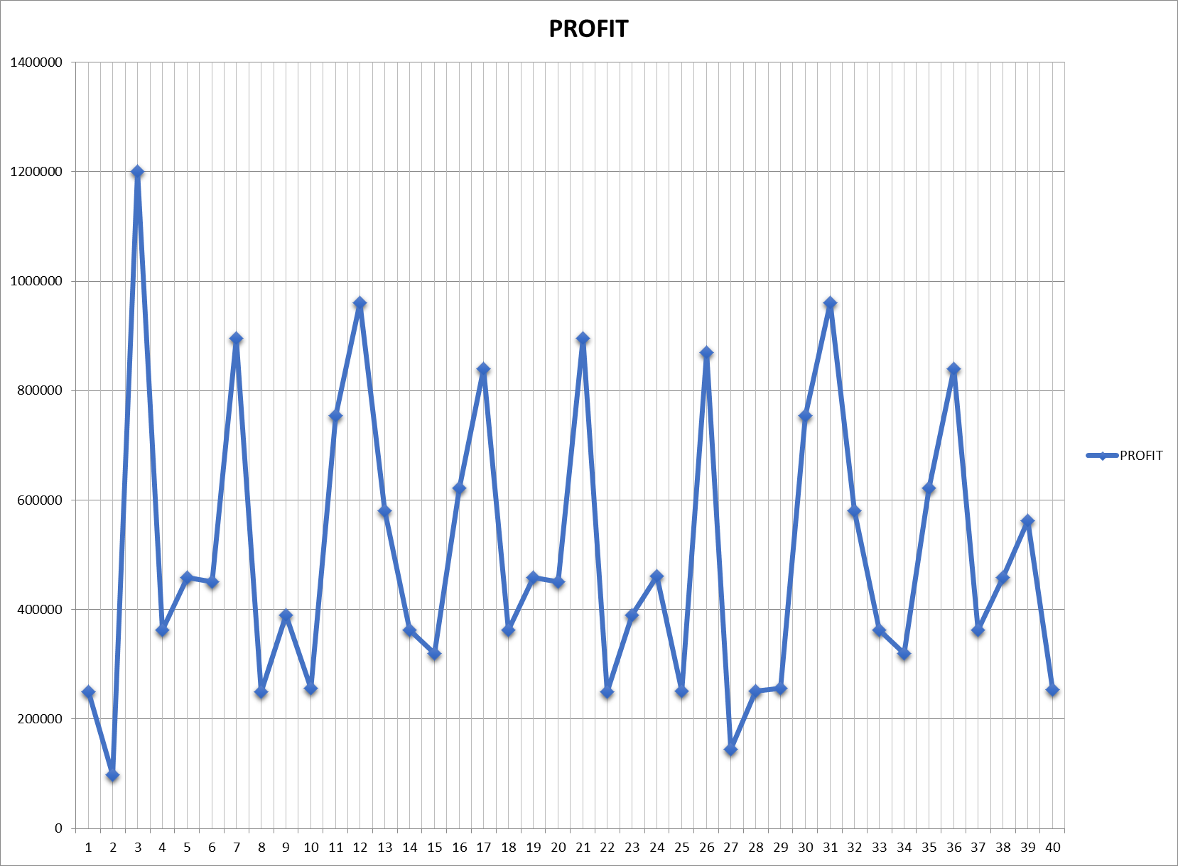
results

Slide 13
Conclusions …
The line chart reveals a concerning decline in profitability over the past quarter, with a significant increase in losses in March. Our analysis suggests that this trend is driven by a combination of factors, including:
- Increasing expenses, particularly in February and March
- Fluctuations in revenue, with a notable dip in January- Potential seasonality effects, with profits typically lower in the first quarter
- Monitor profit and loss trends closely to ensure effective intervention
- Review and adjust business strategies quarterly to ensure alignment with financial goals

